Slide 1


Real-world Translator Retrieval Framework
Navid Rekabsaz (rekabsaz@ifs.tuwien.ac.at)
Mihai Lupu (lupu@ifs.tuwien.ac.at)

Slide 2

Agenda
Translator Retrieval Platform
Proficiency Estimator
Document Aggregation Methods
Experimental Results
Translator Search
Data Annotation
Learning to Rank Methods
Experimental Results
Conclusion

Slide 3
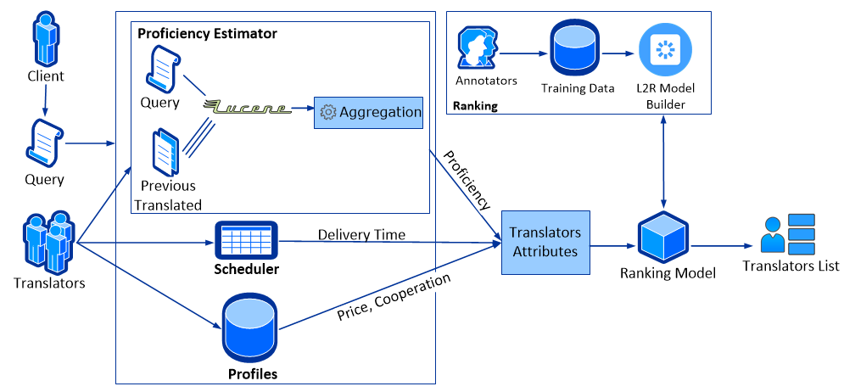
Translator Retrieval Platform

Slide 4





Proficiency Estimator
10 language combinations
20 to 30 potential translators for each order
Using Lucene for document similarity
How to aggregate the documents in order to estimate translator's proficiency?

Slide 5
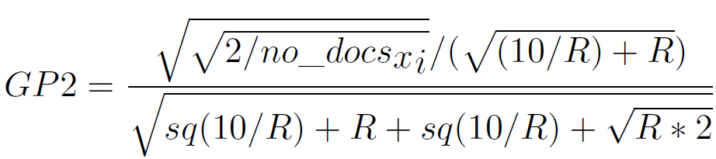
Document Aggregation Methods
Top1
Top5
GP2 (Cummins et al. 2010) uses rank of document among all

Slide 6
Aggregation Methods – Golden Data
181 purchased orders each assessed by a proof-reader from 1 to 5
Proof-readers’ assessments as golden-data
Comparing the outcome list of each algorithm with the golden-data.
Order | GP2 | Top1 | Top5 | Assessment
1 | 0.066 | 14.291 | 14.291 | 4.8
2 | 0.815 | 0.037 | 0.765 | 4.6
3 | 0.088 | 0.031 | 0.339 | 4.4
4 | 0.081 | 1.345 | 1.345 | 3.8
5 | 0.101 | 9.588 | 9.588 | 4

Slide 7
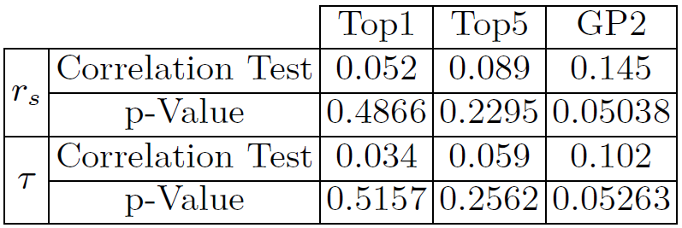
Proficiency Estimator - Experimental Results
Both measures show similar behaviors
GP2 outperforms while approximately weak correlation

Slide 8
Translator Retrieval Platform (Recap)

Slide 9
Data Annotation
Annotation system representing three translators with four criteria (price, delivery time, proficiency and number of cooperations)
Translators' pictures and names are removed
8 annotators
400 annotated lists (1200 records)

Slide 10
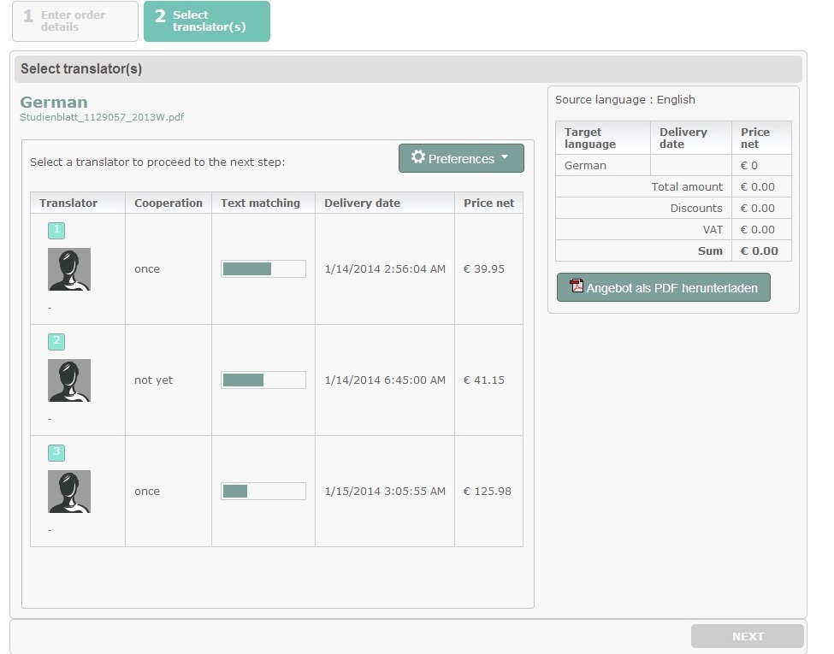
Data Annotation

Slide 11
Learning to Rank Methods
Pointwise: linear or polynomial regression
Pairwise: RankNet, RankBoost, LambdaRank, LambdaMART
Listwise: AdaRank, ListNet
Evaluation
MAP
[N]DCG*
MRR
ERR (Expected Reciprocal Rank)*
* Used for graded relevance

Slide 12
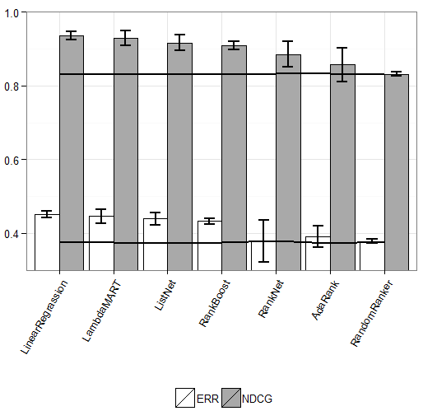
Learning to Rank - Experimental Results

Slide 13
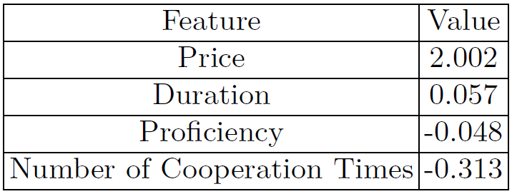
Learning to Rank - Experimental Results
Linear Regression shows the best performance
Feature comparison shows price and duration much more important, while proficiency not effective.

Slide 14
Conclusion
Translator Retrieval price, duration, proficiency and number of cooperation times
GP2 outperforms while approximately weak correlation
Linear Regression
Price and Time much more important

Slide 15
Thank you!
Navid Rekabsaz (rekabsaz@ifs.tuwien.ac.at)
Mihai Lupu (lupu@ifs.tuwien.ac.at)

Slide 23


